Slide 1
CAPSTONE PROJECT Business Insights & Strategic Recommendations for Café Harmony.
BY:
OLUBOWALE SALISU

Slide 2
BUSINESS OVERVIEW
Welcome to Café Harmony, a new and exciting virtual café chain! The café specializes in offering a
variety of drinks, snacks, and light meals to customers. Over the past year, Café Harmony has seen
impressive growth but now faces new challenges as the company is scaling to meet customer
demand. The café has multiple locations across the city, each with its own performance metrics and
unique customer preferences.

Slide 3
AIM OF THE PROJECT
This project aims to provide business insights and recommendations based on the key business questions of Café Harmony. The questions are:
Which top-selling menu product generates the most revenue?
Which customer demographic(age, gender, or preferred items) is driving the highest sales?
Which ingredients or products are most commonly running low across locations?
Identify which locations or employees are performing above or below the average sales target
Analyze customer feedback to identify common themes in satisfaction or dissatisfaction.

Slide 4
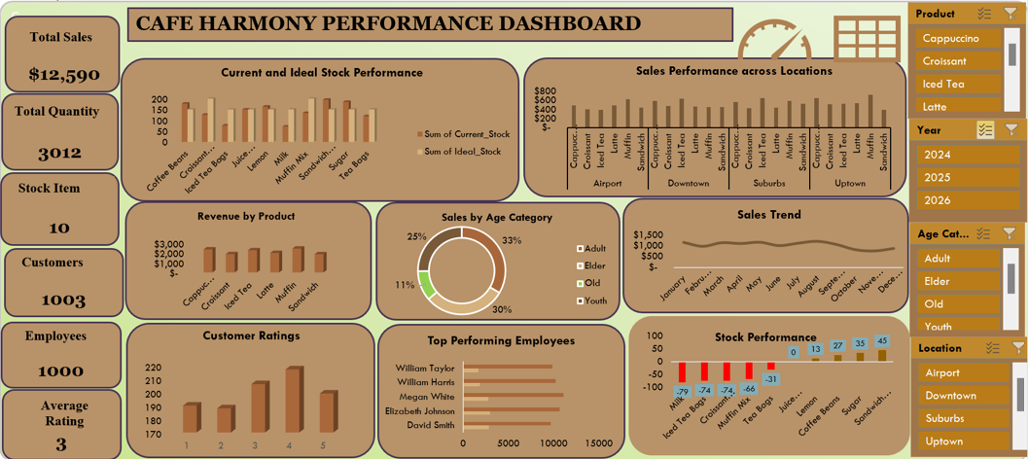
PERFORMANCE DASHBOARD

Slide 5
MENU PERFORMANCE
From the Sales trend chart the month with the highest sales is August(1220 sales) while the month with the lowest sales November(783 sales).
Sales trend suggests seasonal influence or campaign effects.
Recommendation: Launch promotions in low months and replicate August’s strategy.

Slide 6
LOCATION BASED SALES PERFORMANCE
Uptown creates the highest revenue ($3360) .
Airport location underperforms.
Recommendations: Audit low performing branches and replicate successful layouts and strategies from Uptown.

Slide 7
CUSTOMER SPENDING
From the chart the Adult age category spends the most (33%).
Both the Adults and the Elders make over 60% of sales.
Recommendation: Marketing tailored to loyalty programs and menu items (e.g., wellness-oriented beverages, senior discounts) should be encouraged while Youths should be engaged in youth-centric campaigns to increase engagement, and Student discounts should be provided.

Slide 8
STOCK MANAGEMENT
Milk, Crossant Dough, Iced Tea Bag, and Muffin Mix are significantly below the ideal stock levels, indicating potential stock out. Conversely, Coffee Beans, Sandwich Bread, Sugar, and Lemon have higher current stock than the ideal stock, suggesting overstocking.
Recommendation: Reduce wastage and review storage or usage rates. Refine the forecasting model for ingredients with low turnover.
Notes:
Beans

Slide 9
EMPLOYEE PERFORMANCE
Megan White and Elizabeth Johnson are top performers, while Olivia King and Robert Scott are the least performing employees.
Recommendation: Reward high performers with incentives such as a salary increase and promotion, while the low performers require training or reassignment of their job roles.

Slide 10
CUSTOMER RATING
The Average Rating is 3 out of 5.
38% of customers rated the services with 1 or 2 stars.
Recommendation: Improve customer experience via quality audits.
Launch real-time digital feedback with incentives.

Slide 11
OPERATIONAL RECOMMENDATIONS
Boost sales during October–November using seasonal promotions.
Replicate successful marketing strategies from high-performing August.
Balance stock levels: Restock Milk, Muffin Mix; reduce Sugar, Lemon.
Improve stock forecasting and apply just-in-time inventory practices.
Audit low-performing locations (e.g., Airport) and replicate Uptown's strategy.

Slide 12
CUSTOMER AND PRODUCT STRATEGY
Focus loyalty programs on Adults and Elders (over 60% of customers).
Introduce youth-targeted campaigns to increase engagement.
Promote top-selling items (Muffins, Cappuccino, Iced Tea).
Bundle low-selling items (e.g., Sandwiches) with popular products.
Improve service and quality to address low customer ratings (avg rating: 3).

Slide 13
EMPLOYEES AND CUSTOMER EXPERIENCE
Recognize and incentivize top performers (e.g., Megan White).
Underperformers should be laid off (e.g., Olivia King)
Launch digital feedback tools to collect real-time customer insights.
Use customer reviews to continuously improve service delivery.
Encourage customer retention through incentives and loyalty rewards

Slide 14
SUMMARY OF KEY RECOMMENDATIONS
Run seasonal offers and boost low-month sales.
Promote top-selling products and bundle low-selling products.
Optimize stock levels: Restock essentials, reduce waste.
Recognize high-performing staff, lay off low performers.
Enhance customer experience and collect customer feedback in real-time.

Slide 15

THANK YOU FOR LISTENING

